Slide 1

End User Software Engineering
Vishal Dwivedi
Institute for Software Research Carnegie Mellon University
vdwivedi@cs.cmu.edu
Human Aspects for Software Development
Lecture 27.
*Collaborative work with Perla Velasco Elizondo, Jose Maria Fernandes and Bradley Schmerl.

Slide 2
Agenda : The Story of End User Software Engineering (EUSE)
Motivation
Who are end user programmers (EUPs)?
Why do they have problems?
Why should we solve them?
End User Software Engineering (EUSE) and its goals
EUSE in contrast with software engineering
Requirements
Design and Specification
Reuse
Testing
Debugging
Cross Cutting concerns in End User Software Engineering
Open Issues
Conclusion

Slide 3
The story begins with end user programming…
“End-user programming enables end users to create their own programs. Researchers and developers have been working on empowering end users to do this for a number of years - and they have succeeded. Today, millions of end users create numerous programs…”
And they make a mess out of it !!

Slide 4
Revisiting Brad’s Lecture’01
“Programming”
‘‘The process of transforming a mental plan of desired actions for a computer into a representation that can be understood by the computer’’ – Jean-Michel Hoc and Anh Nguyen-Xuan
“Professional Programmer”
Someone whose primary job function is to write or maintain software.
“End-User Programmer”
People who write programs, but not as their primary job function.
Instead, they must write programs in support of achieving their main goal, which is something else.
Covers a wide range of programming expertise
Business analysts, Neuroscientists, Physicists, Teachers, Accountants, etc.
Notes:
Ref: Hoc, J.-M. and Nguyen-Xuan, A., “Language Semantics, Mental Models and Analogy,” in Psychology of Programming, J.-M. Hoc, et al., Editors. 1990, Academic Press. London. pp. 139-156.

Slide 5
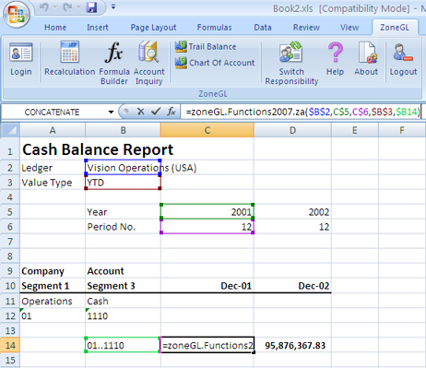
Who are these End User Programmers (EUPs)? A large number (millions) of computer users that use spreadsheets like programs for day to day tasks

Slide 6
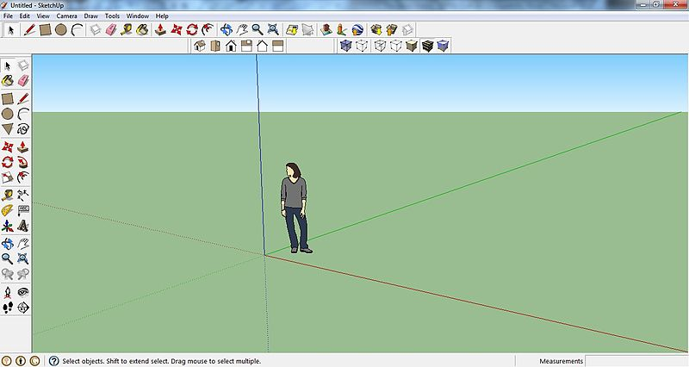
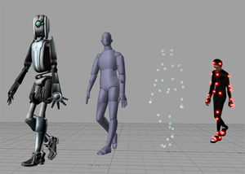
Who are these End User Programmers (EUPs)? Designers: They build 3D models using drawing tools like Google Sketchup
http://sketchup.google.com/

Slide 7
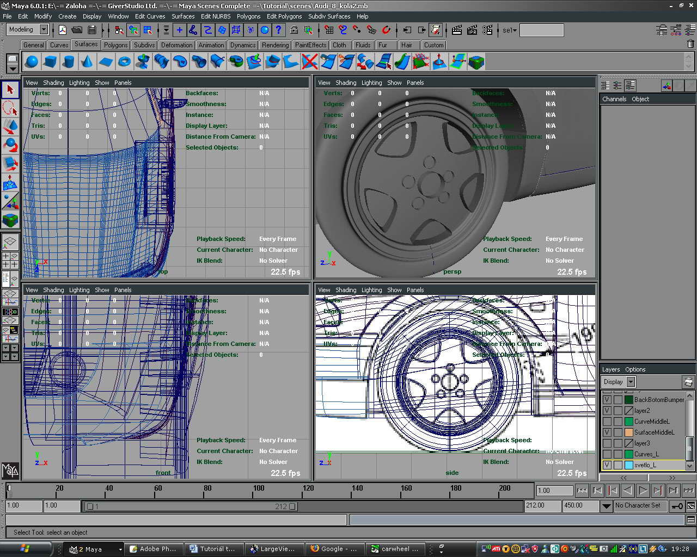
Who are these End User Programmers (EUPs)? Artists: They use tools like Autodesk MAYA to build animations
http://usa.autodesk.com/maya/

Slide 8
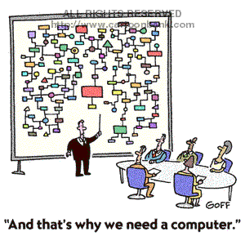
Who are these End User Programmers (EUPs)? Data Analysts: Analyze large volumes of Data
They do tasks like (often manually using tool chains) :
Data preparation and analysis pipelines.
Data preparation pipelines
Data integration pipelines
Data analysis pipelines
Data annotation pipelines
Knowledge extraction.
Parameter sweeps over simulations/computations
Model building and verification
Knowledge management and model population

Slide 9


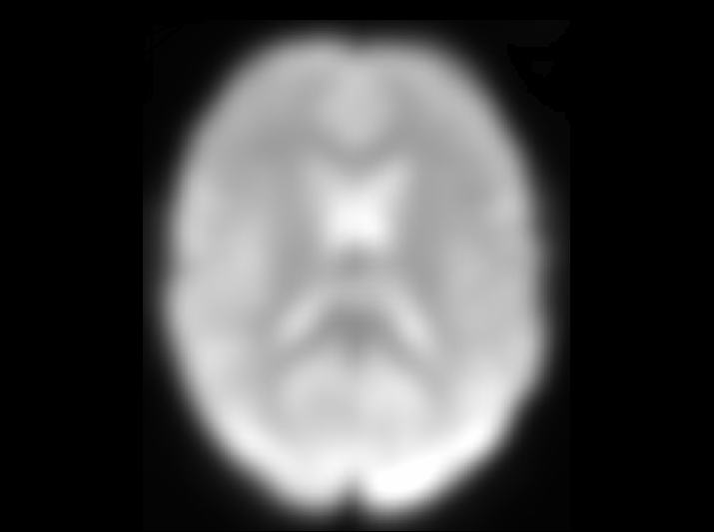

Who are these End User Programmers (EUPs)? Neuroscientists: They performing brain-imaging analyses (and write code scripts for tool composition)
Align
Spatial
filtering
Temporal
filtering

Slide 10
Who are these End User Programmers (EUPs)? Neuroscientists: They performing brain-imaging analyses (and write code scripts for tool composition)
/usr/local/fsl/bin/flirt
-ref standard
-in example_func
-out example_func2standard
-omat example_func2standard.mat
-cost corratio -dof 12
-searchrx -90 90
-searchry -90 90
-searchrz -90 90
-interp trilinear
A large script file that contains program calls
Program (a large number of binaries that
perform one or more functions)
Parameters (numbers range from 5 to 25)

Slide 11
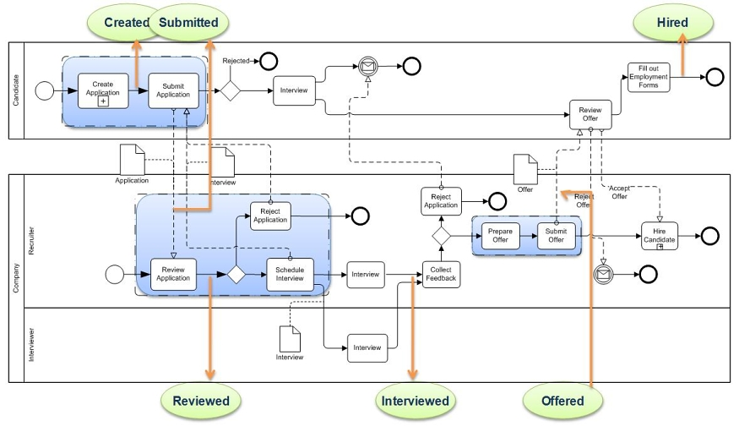
Who are these End User Programmers (EUPs)? Business Analysts: They model workflows for solving business problems

Slide 12
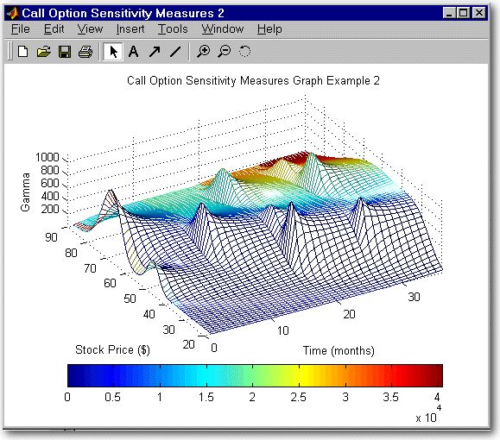
Who are these End User Programmers (EUPs)? Financial Analysts: They build models, and write code in tools like MATLAB

Slide 13

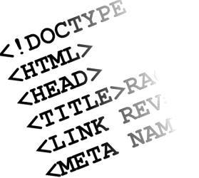

Who are these End User Programmers (EUPs)? They have different programming models (data entry, composition, analysis, …)
Scientists,
Physicists,
Astronomists
Accountants,
Moms and Pops
People with Professional end user software developer role [Segal, 07]
People with a
(technically) novice role
Domains that involve writing a lot of code
Domains that involve adaptations of software, and change in configurations
Domains that involve using or adapting turn-key software
Common theme: For such end users:
The goal of Programming is to support their professional task.
They usually don’t know much about Software Engineering.
They want to get their job done, and make frequent mistakes in the process.

Slide 14
Why do End Users have problems? Software they create is often riddled with errors unless they have specific tool support to address that.
End User programming deals with ‘create’ phase of software development and lack the quality controls of other phases defined by Software Engineering.
No wonder, studies point to the fact that:
94% of spreadsheets deployed in the field contain errors [Powell, 07]
90% of yahoo pipes are erroneous [Kathryn T. Stolee, 2011]
End Users are overconfident in using spreadsheets [Rothermel, 2000]
Notes:
Stephen G. Powell, Kenneth R. Baker, Barry Lawson (2007-12-01). "A Critical Review of the Literature on Spreadsheet Errors". http://mba.tuck.dartmouth.edu/spreadsheet/product_pubs.html. Retrieved 2008-04-18.
K. T. Stolee and S. Elbaum, "Refactoring Pipe-like Mashups for End User Programmers," International Conference on Software Engineering (ICSE), Honolulu, Hawaii, May 2011. to appear.
Karen Rothermel, Curtis Cook, Margaret Burnett, Justin Schonfeld, Thomas Green, and Gregg Rothermel, "WYSIWYT Testing in the Spreadsheet Paradigm: An Empirical Evaluation", International Conference on Software Engineering, Limerick, Ireland, 230-239, June 2000.

Slide 15
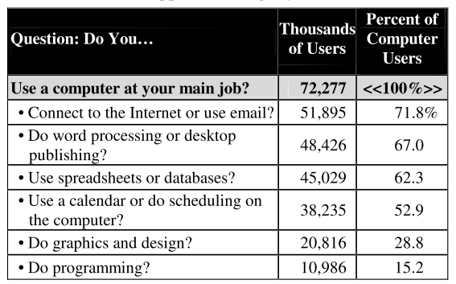
Why should we solve them? Because end users population is huge and offers opportunities to make a big impact
[Scaffidi, 2005]
90 million computer users at work in US
55 million will use spreadsheets or databases at work (and therefore may potentially program)
13 million will describe themselves as programmers
3 million professional programmers
Figure 1: Scaffidi et al’s estimation for 2012
Figure 2: Barry Boehm’s estimation for 2005
Notes:
Christopher Scaffidi, Mary Shaw, Brad A. Myers: Estimating the Numbers of End Users and End User Programmers. VL/HCC 2005: 207-214

Slide 16
Motivation
End User Software Engineering (EUSE) and its goals
EUSE in contrast with software engineering
Cross Cutting concerns in End User Software Engineering
Open Issues
Conclusion

Slide 17
End-User Software Engineering An approach to solve problems with EUP
Focuses on how to support the entire software lifecycle as opposed to the ‘create’ phase of EUP
End-user programming that involves systematic and disciplined activities that address software quality issues (such as reliability, efficiency, usability, etc.). But these activities are secondary to the goal the program is helping to achieve.
Is proposed to be an intersection of Software Engineering, HCI, Psychology and Education Research and uses techniques from all these areas.
Software
Engineering
HCI
and
Psychology
Education

Slide 18
Goals of End-User Software Engineering
Reduce errors in end-user programs by providing supporting activities, such as:
Design and composition of systems from elements
Support for Evolution, development, maintenance
Deliberate process for creating software
Expressiveness and understandability
Sufficient dependability for current need
Concern for system properties – usability, dependability, security, privacy
And more…
Note: the tension between ‘opportunism’ and ‘systematic planning’. This is an underlying issue for this domain.
Adapted from slide 2 from Prof Mary Shaw’s talk at 4th Workshop on End-User Software Engineering at ICSE’08

Slide 19
Motivation
End User Software Engineering (EUSE) and its goals
EUSE in contrast with software engineering
Requirements
Design and Specification
Reuse
Testing
Debugging
Cross Cutting concerns in End User Software Engineering
Open Issues
Conclusion

Slide 20
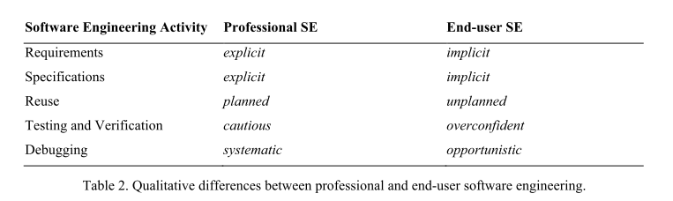
EUSE vs SE End User programmers ARE NOT software engineers
[Andrew Ko, 2011]
End users don’t follow the standard, well established processes defined by Software Engineering principals.
Their approach to development can be best characterized as unplanned, implicit, and opportunistic, primarily due to the priorities and intents of the programmer (but perhaps also to inexperience).
Notes:
Ko, A. J., Abraham R., Beckwith L., Blackwell A., Burnett M.M., Erwig M., Scaffidi C., Lawrence J., Lieberman H., Myers B.A., Rosson M.B., Rothermel G., Shaw M. and Wiedenbeck S. (in press). The State of the Art in End-User Software Engineering, ACM Computing Surveys, to appear.

Slide 21
Requirements Requirements Evolve over time and are the process is often implicit
Requirements analysis is often an informal process, and there is no “requirement gathering phase” as in Software Engineering practice.
Requirements often become clear in the process of implementation.
They are often derived from informal channels, such as:
Beliefs about the users of the program.
Constant Tinkering by hobbyist where they have no definite end in mind
Negotiation at work
[Andrew Ko, 2011]
[Costabile, 2006]
[Blackwell, 2006]
[Andrew Ko, 2007]
Notes:
Ko, A. J., Abraham R., Beckwith L., Blackwell A., Burnett M.M., Erwig M., Scaffidi C., Lawrence J., Lieberman H., Myers B.A., Rosson M.B., Rothermel G., Shaw M. and Wiedenbeck S. (in press). The State of the Art in End-User Software Engineering, ACM Computing Surveys, to appear.
Maria Francesca Costabile, Daniela Fogli, Piero Mussio, Antonio Piccinno. End-user development: the software shaping workshop approach. In Lieberman, H., Paternò, F., Wulf, V. (Eds) (2004) End User Development - Empowering People to Flexibly Employ Advanced Information and Communication Technology, © 2004 Kluwer Academic Publishers, Dordrecht, The Netherlands.
Blackwell, A.F. 2006. Gender in domestic programming: From bricolage to séances d'essayage. Presentation
at CHI Workshop on End User Software Engineering.

Slide 22
Design Only limited work exists in the end user design space – and it points to implicit design
Studies point at end users being silent designers, with no training in design. [Gorb and Dumas, 1987]
Most of the end user design studies are directed towards improving the quality of XL sheets, such as for:
Improving the reliability [Ronen et al, 1989]
Best practices for improving quality [Powell and Baker, 2004]
Other design related works include :
Constraining designs for web based application development as in Websheets [Wolber, 2002] or Click [Rode et al, 2005]
Wong et al [Wong, 2007] used patterns in mashups as a design activity. Their survey found several types of patterns:
Aggregation
Alternate UI or specialized use
Personalization
Focused view of data
Notes:
Gorb, P, and Dumas, A. 1987. ‘Silent Design’, Design Studies, 8, 150-156.
Ronen B. AND Palley M.A., Lucas Jr. H.C. 1989. Spreadsheet analysis and design, Communications of the ACM, 32(1):84-93.
Powell S. G. and Baker K.R. 2004. The Art of Modeling with Spreadsheets: Management Science, Spreadsheet Engineering, and Modeling Craft, Wiley.
Wolber D., Su Y., Chiang Y.T. 2002. Designing dynamic web pages and persistence in the WYSIWYG interface. International Conference on Intelligent User Interfaces, San Francisco, California, USA, January, 228-229.
Rode J., Bhardwaj Y, Perez-Quinones M.A, Rosson M.B, and Howarth J. 2005. As easy as “Click”: End-user web engineering. International Conference on Web Engineering, Sydney, Australia, July, 478-488.
Wong, J. and Hong J.I. 2007. Making mashups with Marmite: Re-purposing web content through end-user programming. Proceedings of ACM Conference on Human Factors in Computing Systems.

Slide 23
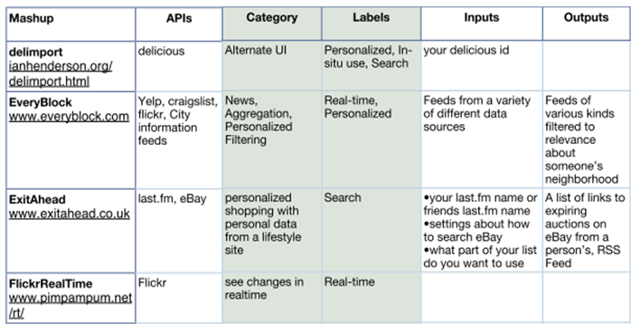
Design Patterns in Mashups [Wong et al, 2007]

Slide 24
Reuse Composition/Packaging as a form of Reuse
Models for composition of elements
Use patterns to guide mashups [Wong]
Managing service compositions with many component proprietors [Coutaz]
Package new capability as plugins or extensions for existing systems [Scaffidi, Stoitsev, Sestoff]
Moving data among applications and integrating with existing applications by packaging data as plugins of various kinds
Finding resources
Provide hierarchy of repositories from personal to local to global [Scaffidi]
Finding services [Doerner]
Notes:
Wong, J. and Hong J.I. 2007. Making mashups with Marmite: Re-purposing web content through end-user programming. Proceedings of ACM Conference on Human Factors in Computing Systems.
Christian Dörner, Volkmar Pipek, Markus Won: Supporting expertise awareness: finding out what others know. CHIMIT 2007: 9
Christopher Scaffidi, Christopher Bogart, Margaret M. Burnett, Allen Cypher, Brad A. Myers, Mary Shaw: Predicting reuse of end-user web macro scripts. VL/HCC 2009: 93-100

Slide 25
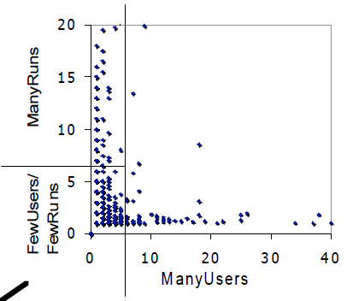
Reuse Repositories of end-user code: The good, the great, and the “other”
[Bogart, 2008]
Of 1445 CoScripter macros
~ 10% had many runs
~ 10% had many users
~ 80% were “other”
This is one of the largest web macro repository, with > 6000 users, > 3000 “public” scripts
Code-scripter Demo
C. Bogart, et al. End-User Programming in the Wild: A Field Study of CoScripter Scripts. VL/HCC 2008.
Notes:
BOGART C., BURNETT M.M., CYPHER A. AND SCAFFIDI C. 2008. End-user programming in the wild: A field study of CoScripter scripts. IEEE Symposium on Visual Languages and Human-Centric Computing, 2008

Slide 26
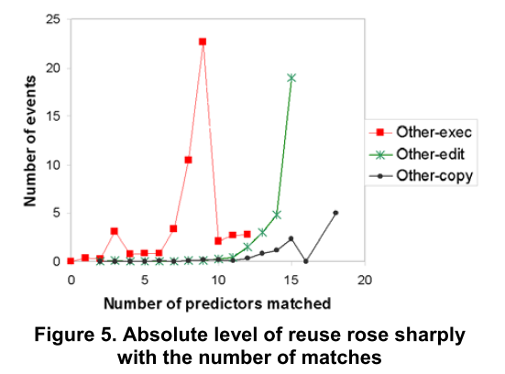
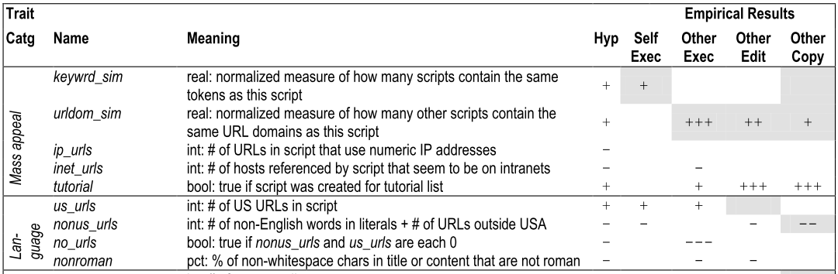
Reuse Predicting Reuse of End-User Web Macro Scripts
[Scaffidi, 2009]
Identified 35 candidate traits in 8 categories
Mass appeal – eg popular keywords F
Language – eg data values are in English U
Annotations – eg comments U
Flexibility – eg parameterization (variables) M
Length – eg small # distinct lines of code UM
Author information – eg at IBM IP address M
Advanced syntax – eg “control-click” keyword UM
No Preconditions – eg no cookies needed M
F = findability, U = understandability, M = not modifying
Notes:
Christopher Scaffidi, Christopher Bogart, Margaret M. Burnett, Allen Cypher, Brad A. Myers, Mary Shaw: Predicting reuse of end-user web macro scripts. VL/HCC 2009: 93-100

Slide 27
Testing and Verification Is my program working correctly?
Problem: End users are imperfect Oracles, and don not really answer this question !!
Studies point that professional programmers tend to be overconfident [Leventhal et al. 1994, Lawrance et al. 2005], but this overconfidence subsides when they gain experience [Ko et al. 2007]
However, some end user programmers (mostly in the spreadsheet world) tend to notoriously overconfident, and despite high error rates such uses are highly confident about the correctness of their spreadsheets. [Panko 1998, Hendry and Green 2000, Ruthruff 2005, Pahlgune 2005]
Implication: Immediate feedback of computation values, without feedback about correctness leads to higher over confidence. [ Rothermel et al. 2001, Krishna et al. 2001]
Notes:
Teasley B. and Leventhal L. 1994. Why software testing is sometimes ineffective: Two applied studies of positive test strategy. Journal of Applied Psychology 79(1), 142-155.
Joseph Lawrance, Steven Clarke, Margaret M. Burnett, Gregg Rothermel: How Well Do Professional Developers Test with Code Coverage Visualizations? An Empirical Study. VL/HCC 2005: 53-60
Panko R. 1998. What we know about spreadsheet errors. Journal of End User Computing, 2, 15–21.
Hendry, D. G. and Green, T. R. G. 1994. Creating, comprehending, and explaining spreadsheets: A cognitive interpretation of what discretionary users think of the spreadsheet model. International Journal of Human-Computer Studies, 40(6), 1033-1065.
Ruthruff J., Burnett M., and Rothermel G. 2005. An empirical study of fault localization for end-user programmers. International Conference on Software Engineering, St. Louis, Missouri, May, 352-361.
Phalgune A., Kissinger C., Burnett M., Cook C., Beckwith L., and Ruthruff J.R. 2005. Garbage in, garbage out? An empirical look at oracle mistakes by end-user programmers. IEEE Symposium on Visual Languages and Human-Centric Computing, Dallas, TX, September, 45-52.
Rothermel G., Burnett M., LI L., Dupuis C. and Sheretov A. 2001. A Methodology for testing spreadsheets. ACM Transactions on Software Engineering Methodologies, 10(1), 110-147.
Vijay B. Krishna, Curtis R. Cook, Daniel Keller, Joshua Cantrell, Chris S. Wallace, Margaret M. Burnett, Gregg Rothermel: Incorporating Incremental Validation and Impact Analysis into Spreadsheet Maintenance: An Empirical Study. ICSM 2001: 72-81

Slide 28
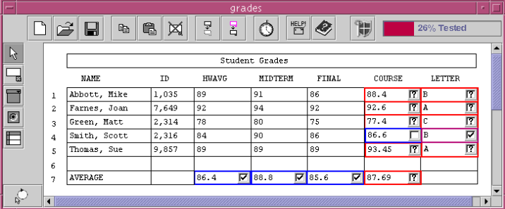
Testing and Verification WYSIWYT: What you see is what you test
[Rothermel et al 2001]
Checkmarks represent decisions about correct values
Empty boxes indicate that a value has not been validated
Question mark indicates that validation the cell would increase the cells testedness
Notes:
Rothermel G., Burnett M., Li L., Dupis C. and Shertov A. 2001. A Methodology for testing spreadsheets. ACM Transactions on Software Engineering Methodologies, 10(1), 110-147.

Slide 29
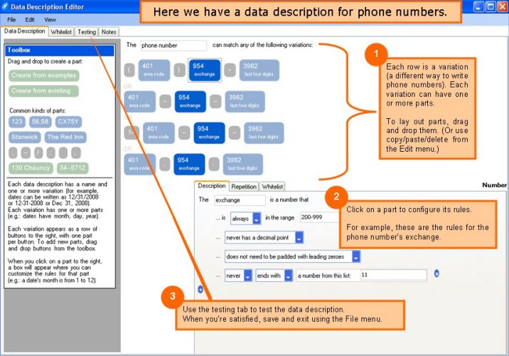

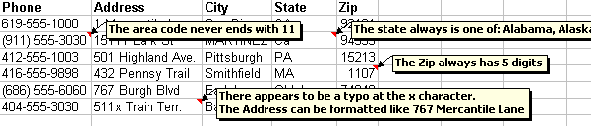
Testing and Verification TOPES: providing a usable mechanism for spreadsheet validation
[Scaffidi, 2008]
Notes:
Scaffidi C., Myers B.A., AND Shaw M. 2008. Topes: Reusable abstractions for validating data. International Conference on Software Engineering, Leipzig, Germany, May 2008, 1-10.

Slide 30

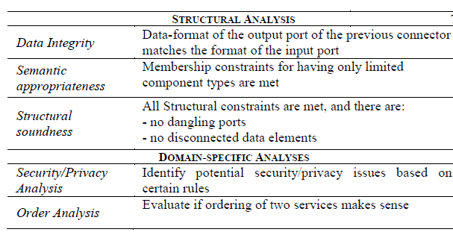
Testing and Verification Verification by domain-specific analysis in SWiFT
Missing Alignment before temporal filtering

Slide 31
Motivation
End User Software Engineering (EUSE) and its goals
EUSE in contrast with software engineering
Cross Cutting concerns in End User Software Engineering
Motivating End users to use EUSE
Training End Users
Gender Issues for EUSE
Empirical Studies
Open Issues
Conclusion

Slide 32
Motivating End users to use EUSE Seek attention/Surprise
“Attention Investment model” [A. F. Blackwell, 2002]
Models how users make decisions about what kinds of features users should have in their software.
Costs: learning time & actual programming time
Time away from the “real work”
Benefits: future savings if task done again. But users need to incur costs to gain the benefits.
Risks: won’t work & be a waste of time
“Surprise-Explain-Reward” [Burnett]
Surprise: Make users curious by showing the presence of an information gap.
Explain: Let the users seek explanation
Rewards: Make benefits of taking those actions clear early.
Notes:
Margaret M. Burnett: What Is End-User Software Engineering and Why Does It Matter? IS-EUD 2009: 15-28
A. F. Blackwell. “First steps in programming: a rationale for attention investment models,” IEEE HCC-VL’02, Arlington, VA. pp.2-10

Slide 33
Training End Users
[Umarji, 2008]
Umarji Pohl and Seaman approach to Teaching SE to end users
Surveyed bioinformatics curricula and recommended things that these users should know about SE
Recommendations
Approaches to software design and development
Strong quality assurance (QA) practices
Evolutionary perspective
Documentation
Reuse
However, the impact of such teaching on quality assurance is unknown.
Andrew Ko et al, instead argue for exploring “teachable moments” using the Surprise-explain-reward approach
Notes:
Umarji, M., Pohl, M., Seaman, C., Koru, A. G., and Liu, H. 2008. Teaching software engineering to end-users. International Workshop on End-User Software Engineering, Leipzig, Germany, May 40-42.

Slide 34
Empirical Studies Gender Concerns for End Users [Burnett et al, 2011]
Research Question
Are the strategies employed by male and female EUSE in debugging different?
Domain
Spreadsheets
Method
Experiment, qualitative study
Subjects/Objects of study
Males, females, professionals, students
Results
There are significant gender differences in strategies for approaching testing and debugging
Some of the strategies preferred by females are not well supported in end-user environments
Modeling of problem solving behavior may improve females’ confidence, and therefore their performance on tasks
Gender matters
Notes:
Margaret M. Burnett, Scott D. Fleming, Shamsi Iqbal, Gina Venolia, Vidya Rajaram, Umer Farooq, Valentina Grigoreanu, Mary Czerwinski: Gender differences and programming environments: across programming populations. ESEM 2010

Slide 35
Empirical Studies Spreadsheet debugging behavior of expert and novice end-users [Bishop, McDaid, 2011]
Research Question
Comparing performance of expert vs. novice users in detecting and correcting errors, debugging behavior, and cell inspection coverage
Domain
Spreadsheet
Method
Experiment, Qualitative inquiry
Subjects/Objects of study
13 professionals (experts) and 34 accounting and finance students (novices)
Results
Experts perform better than novices at detecting errors that require ‘deep’ understanding
Cell coverage correlates with performance - experts look at more cells than novices
There is a specific pattern of cell inspection depending on the characteristics and place of the cell in the spreadsheet
A tool whose aim was to increase cell inspection coverage showed a trend, but did not significantly improve performance.
Notes:
Brian Bishop, Kevin McDaid: Expert and Novice End-User Spreadsheet Debugging: A Comparative Study of Performance and Behaviour. JOEUC 23(2): 57-80 (2011)

Slide 36
Empirical Studies Patterns in Mashups [Wong et al, 2007]
Research Question
Are there typical application domains for mash-ups?
Domain
Web programming/mash-ups
Method
Survey (in the sense of categorization of) of and qualitative analysis mash-ups
Subjects/Objects of study
Popular Grease Monkey scripts and 22 recommended mash-ups
Results
Mashups can be categorized according to their functionality. These patterns include personalization, search, aggregation amongst others
Notes:
Wong, J. and Hong J.I. 2007. Making mashups with Marmite: Re-purposing web content through end-user programming. Proceedings of ACM Conference on Human Factors in Computing Systems.

Slide 37
Motivation
End User Software Engineering (EUSE) and its goals
EUSE in contrast with software engineering
Cross Cutting concerns in End User Software Engineering
Open Issues
Conclusion

Slide 38
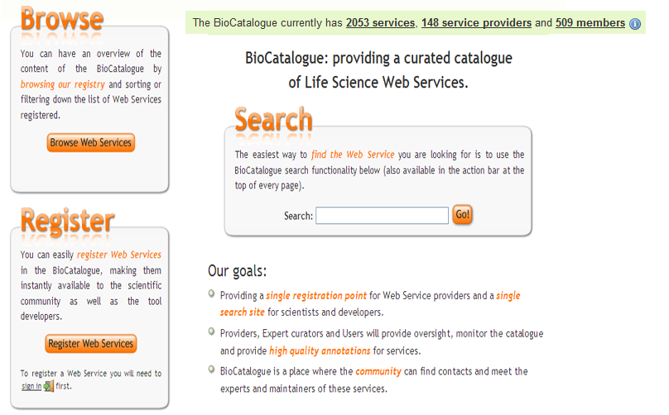


Opportunities to learn from successful software eco-systems Something that has worked really well for bio-informatics domain
Biocatalogue

Slide 39
End users form a large community with varying computation models Should/Can we generalize the results from one world to the other?
Scientists,
Physicists,
Astronomists
Accountants,
Moms and Pops
People with Professional end user software developer role [Segal, 07]
People with a
(technically) novice role
Domains that involve writing a lot of code
Domains that involve adaptations of software, and change in configurations
Domains that involve using or adapting turn-key software

Slide 40
EUSE research is (kind of) silent about ‘domain’
Technology expertise ++
Novices: Who use/adapt turn-key software
Write some code
Experts: Who write extensive code
Domain expertise ++
Novice about domain functions
Intermediate knowledge about the domain
Expert in the domain

Slide 41
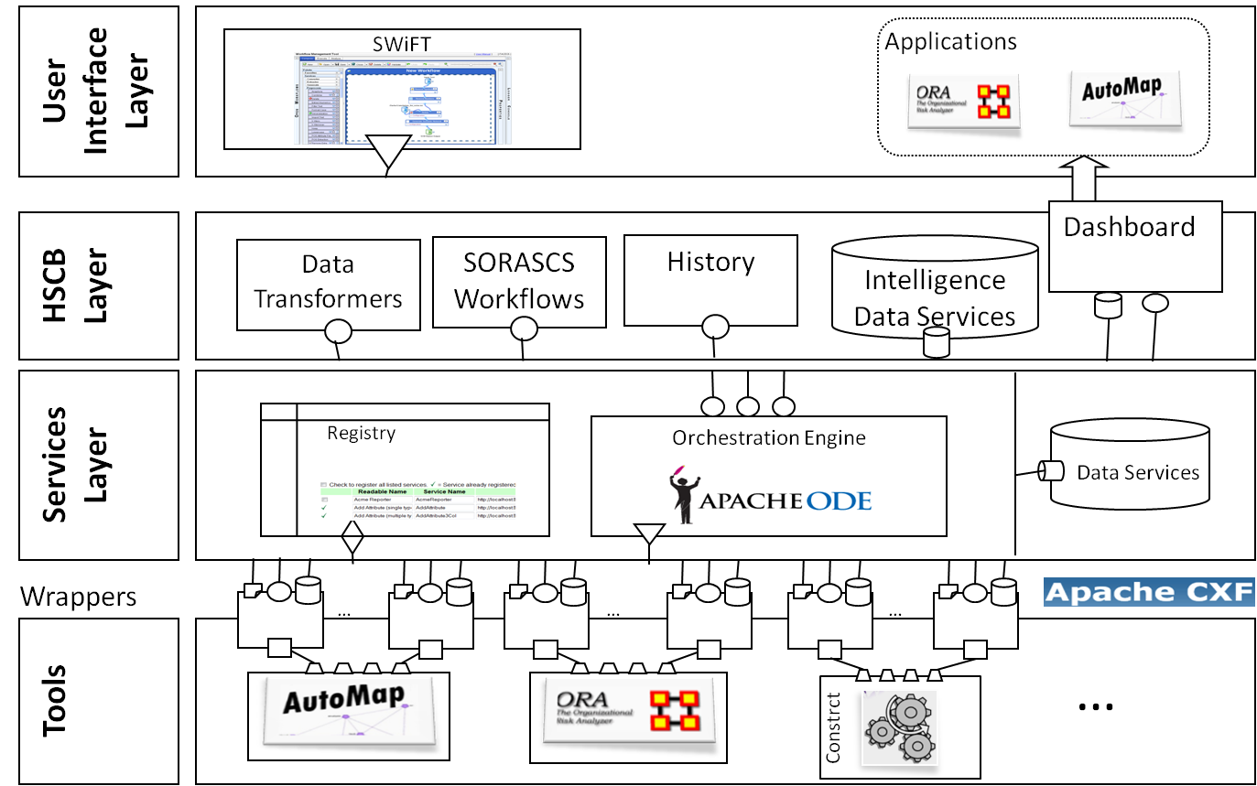

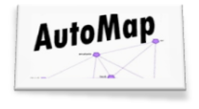
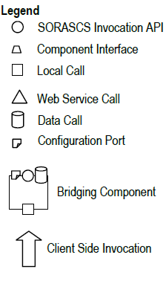




To support users like neuroscientists, biologists, social-scientists and analysts, UI is not enough. EUSE needs a good argument about their domain.
[Schmerl, 2011]
User Interface Layer
SWiFT
Applications
Providing reusable services was not enough, We needed this domain
specific layer for SORASCS
Client
Socio-Cultural Analysis
Data Transformers
SORASCS Workflows
History
Intelligence Data Services
Services Layer
Registry
Orchestration Engine
Data Services
Wrappers
…
…
…
Tools
…
Construct

Slide 42
Conclusions
End User Software Engineering is an emerging field and seems to have a great potential to positively affect the lives of millions of end users.
Some great work has been done by researchers for users using spreadsheets and similar software. However, there are other open areas that need further exploration.
There continues to be a process tension between:
“opportunism” as shown by end users, and
“systematic process” as defined by Software Engineering
Researchers still need to figure out a way to resolve that.
Perhaps the community still needs a better answer to the question: “If you build it, will they come?”

Slide 43
Thank You !!

Slide 44
References
Stephen G. Powell, Kenneth R. Baker, Barry Lawson (2007-12-01). "A Critical Review of the Literature on Spreadsheet Errors". http://mba.tuck.dartmouth.edu/spreadsheet/product_pubs.html. Retrieved 2008-04-18.
K. T. Stolee and S. Elbaum, "Refactoring Pipe-like Mashups for End User Programmers," International Conference on Software Engineering (ICSE), Honolulu, Hawaii, May 2011. to appear.
Karen Rothermel, Curtis Cook, Margaret Burnett, Justin Schonfeld, Thomas Green, and Gregg Rothermel, "WYSIWYT Testing in the Spreadsheet Paradigm: An Empirical Evaluation", International Conference on Software Engineering, Limerick, Ireland, 230-239, June 2000.
Christopher Scaffidi, Mary Shaw, Brad A. Myers: Estimating the Numbers of End Users and End User Programmers. VL/HCC 2005: 207-214
Ko, A. J., Abraham R., Beckwith L., Blackwell A., Burnett M.M., Erwig M., Scaffidi C., Lawrence J., Lieberman H., Myers B.A., Rosson M.B., Rothermel G., Shaw M. and Wiedenbeck S. (in press). The State of the Art in End-User Software Engineering, ACM Computing Surveys, to appear.
Ko, A. J., Abraham R., Beckwith L., Blackwell A., Burnett M.M., Erwig M., Scaffidi C., Lawrence J., Lieberman H., Myers B.A., Rosson M.B., Rothermel G., Shaw M. and Wiedenbeck S. (in press). The State of the Art in End-User Software Engineering, ACM Computing Surveys, to appear.
Maria Francesca Costabile, Daniela Fogli, Piero Mussio, Antonio Piccinno. End-user development: the software shaping workshop approach. In Lieberman, H., Paternò, F., Wulf, V. (Eds) (2004) End User Development - Empowering People to Flexibly Employ Advanced Information and Communication Technology, © 2004 Kluwer Academic Publishers, Dordrecht, The Netherlands.
Blackwell, A.F. 2006. Gender in domestic programming: From bricolage to séances d'essayage. Presentation
at CHI Workshop on End User Software Engineering.
Andrew J. Ko, Robert DeLine, Gina Venolia: Information Needs in Collocated Software Development Teams. ICSE 2007: 344-353

Slide 45
References
Gorb, P, and Dumas, A. 1987. ‘Silent Design’, Design Studies, 8, 150-156.
Ronen B. AND Palley M.A., Lucas Jr. H.C. 1989. Spreadsheet analysis and design, Communications of the ACM, 32(1):84-93.
Powell S. G. and Baker K.R. 2004. The Art of Modeling with Spreadsheets: Management Science, Spreadsheet
Engineering, and Modeling Craft, Wiley.
Wolber D., Su Y., Chiang Y.T. 2002. Designing dynamic web pages and persistence in the WYSIWYG interface. International Conference on Intelligent User Interfaces, San Francisco, California, USA, January, 228-229.
Rode J., Bhardwaj Y, Perez-Quinones M.A, Rosson M.B, and Howarth J. 2005. As easy as “Click”: End-user web engineering. International Conference on Web Engineering, Sydney, Australia, July, 478-488.
Wong, J. and Hong J.I. 2007. Making mashups with Marmite: Re-purposing web content through end-user programming. Proceedings of ACM Conference on Human Factors in Computing Systems.
Christian Dörner, Volkmar Pipek, Markus Won: Supporting expertise awareness: finding out what others know. CHIMIT 2007: 9
Christopher Scaffidi, Christopher Bogart, Margaret M. Burnett, Allen Cypher, Brad A. Myers, Mary Shaw: Predicting reuse of end-user web macro scripts. VL/HCC 2009: 93-100
Teasley B. and Leventhal L. 1994. Why software testing is sometimes ineffective: Two applied studies of positive test strategy. Journal of Applied Psychology 79(1), 142-155.
Joseph Lawrance, Steven Clarke, Margaret M. Burnett, Gregg Rothermel: How Well Do Professional Developers Test with Code Coverage Visualizations? An Empirical Study. VL/HCC 2005: 53-60
Panko R. 1998. What we know about spreadsheet errors. Journal of End User Computing, 2, 15–21.
Hendry, D. G. and Green, T. R. G. 1994. Creating, comprehending, and explaining spreadsheets: A cognitive interpretation of what discretionary users think of the spreadsheet model. International Journal of Human-Computer Studies, 40(6), 1033-1065.

Slide 46
References
Ruthruff J., Burnett M., and Rothermel G. 2005. An empirical study of fault localization for end-user programmers. International Conference on Software Engineering, St. Louis, Missouri, May, 352-361.
Phalgune A., Kissinger C., Burnett M., Cook C., Beckwith L., and Ruthruff J.R. 2005. Garbage in, garbage out? An empirical look at oracle mistakes by end-user programmers. IEEE Symposium on Visual Languages and Human-Centric Computing, Dallas, TX, September, 45-52.
Rothermel G., Burnett M., LI L., Dupuis C. and Sheretov A. 2001. A Methodology for testing spreadsheets. ACM Transactions on Software Engineering Methodologies, 10(1), 110-147.
Vijay B. Krishna, Curtis R. Cook, Daniel Keller, Joshua Cantrell, Chris S. Wallace, Margaret M. Burnett, Gregg Rothermel: Incorporating Incremental Validation and Impact Analysis into Spreadsheet Maintenance: An Empirical Study. ICSM 2001: 72-81
Umarji, M., Pohl, M., Seaman, C., Koru, A. G., and Liu, H. 2008. Teaching software engineering to end-users. International Workshop on End-User Software Engineering, Leipzig, Germany, May 40-42.
Margaret M. Burnett, Scott D. Fleming, Shamsi Iqbal, Gina Venolia, Vidya Rajaram, Umer Farooq, Valentina Grigoreanu, Mary Czerwinski: Gender differences and programming environments: across programming populations. ESEM 2010
Margaret M. Burnett: What Is End-User Software Engineering and Why Does It Matter? IS-EUD 2009: 15-28
Brian Bishop, Kevin McDaid: Expert and Novice End-User Spreadsheet Debugging: A Comparative Study of Performance and Behaviour. JOEUC 23(2): 57-80 (2011)
Scaffidi C., Myers B.A., AND Shaw M. 2008. Topes: Reusable abstractions for validating data. International
Conference on Software Engineering, Leipzig, Germany, May 2008, 1-10.
Rothermel G., Burnett M., Li L., Dupis C. and Shertov A. 2001. A Methodology for testing spreadsheets. ACM Transactions on Software Engineering Methodologies, 10(1), 110-147.
Bradley Schmerl, David Garlan, Vishal Dwivedi, Michael Bigrigg, and Kathleen M. Carley, SORASCS: A Case Study in SOA-based Platform Design for Socio-Cultural Analysis, ICSE 2011, To Appear

